Slide 1

Think about an app or a website you use every day
What sort of data do you think it collects about you?
Notes:
https://time.com/6108001/data-protection-richard-stengel/

Slide 2

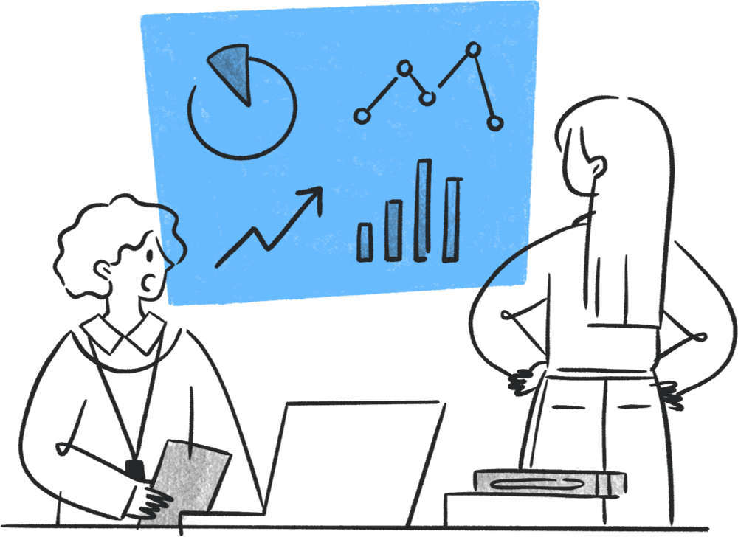

Slide 3
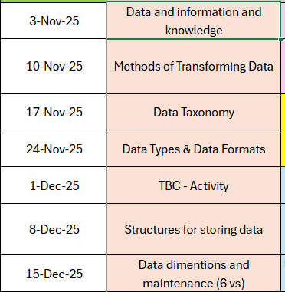
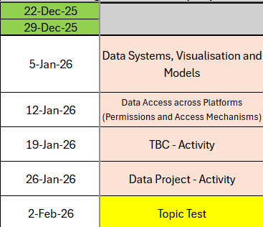

Slide 4
Recap
What is the definition of data?
What does veracity mean in the context of data collection?
What are the 2 pieces of legislation that relate to how we store data?
Name one of the 5 types of data sources

Slide 5

Why might an organisation collect user data?

Slide 6

Learning Objectives
-Describe how organisations use data and information for decision making
-Identify examples of data use
-Explain how data is transformed through manipulation, analysis and processing
-Judge the suitability and ethics of organisational data use

Slide 7

Organisational data use

Slide 8

We’re going to look at how organisations use data, and what for, using the case study from your flipped study

Slide 9

Amazon collects huge amounts of customer and system data every second
A former executive once said ‘they happen to sell products, but are a data company’

Slide 10

Every click, search, purchase or review adds to Amazon’s data lake
This data fuels everything from recommendations to logistics to advertising

Slide 11

Five ways Amazon uses data

Slide 12

Identifying patterns
Tracks what people buy and when to predict future demand

Slide 13

System performance
Monitors warehouse speeds, delivery times, website uptime

Slide 14
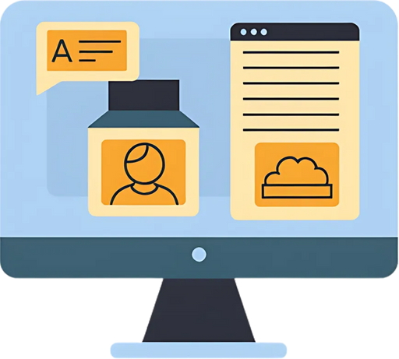
User monitoring
Logs sessions, searches, reviews and device use

Slide 15
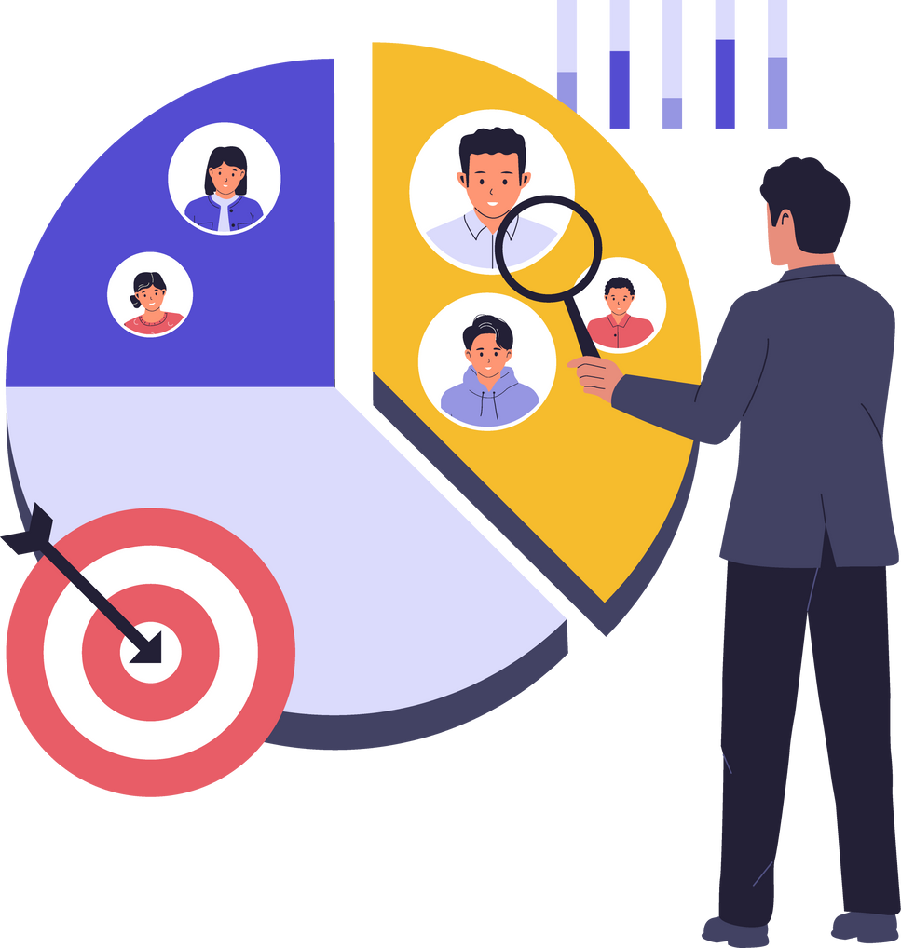
Targeted marketing
Suggests products, offers, and adverts based on behaviour

Slide 16

Threat and Opportunity Analysis
Watches competitors, pricing trends and market shifts

Slide 17

Which of these data uses do you think brings Amazon the biggest profit?

Slide 18

What ethical or security concerns did you find in your research?

Slide 19
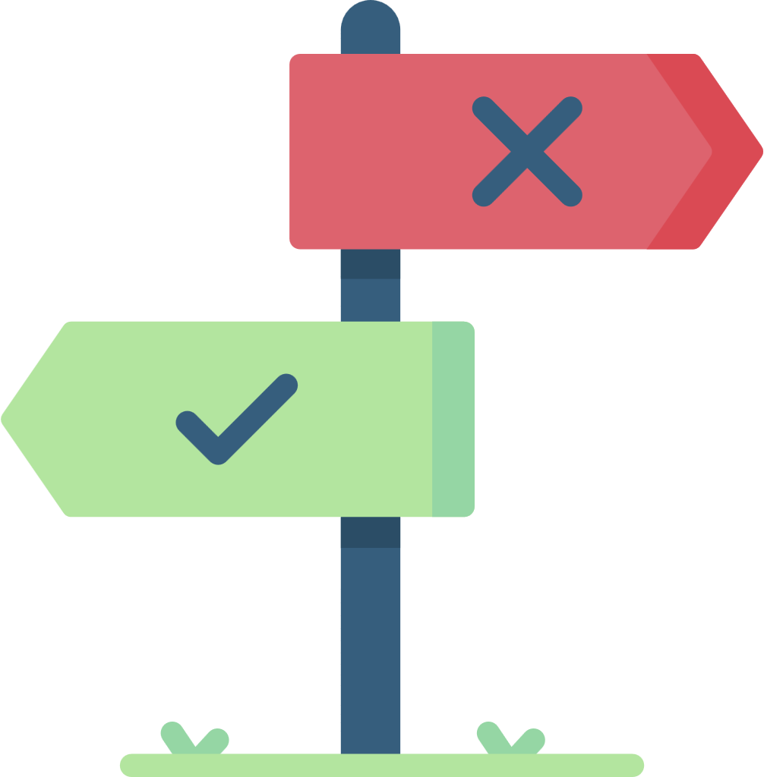
You’re running a company
You need to decide:
What data you’d collect and why
How you’d use it
An ethical safeguard you’d put in place
Notes:
Extensions:
Mid- One possible risk of their data plan and how to reduce it
High- How could this data use lead to unintended consequences?

Slide 20
You’ve just done what real digital teams do. Plan how data supports a business and stays fair to users
Before we move on, look around. All ideas here were different. That shows there no single ‘right’ way to use data

Slide 21

Which sector (public, private, or tech), do you think faces the biggest ethical challenges around data use?
Why?

Slide 22
We’ve delved into the ethics of data previously and how
But what happens when data is access or changed without permission?
This is where the Computer Misuse Act comes in, to protect data from being used in the wrong way

Slide 23

Responsible Data use = Consent + Access Rights
Misuse = Unauthorised access change or sharing

Slide 24
Offence Type 1
Unauthorised access to computer material
Accessing or viewing data without permission
Guessing someone’s login to look at their files
Max Sentence: Up to 2 years in prison and potential fine
Notes:
Computer Misuse Act 1990
Computer Misuse Act (1990) - Ethical, legal and environmental impact - CCEA - GCSE Digital Technology (CCEA) Revision - BBC Bitesize

Slide 25
Offence Type 2
Unauthorised access to with intent to commit or facilitate further offences
Accessing data to commit another crime (fraud, theft)
Hacking a system to steal personal data or bank details
Up to 5 years imprisonment and potential fine

Slide 26
Offence Type 3
Unauthorised modification of computer material
Changing, deleting or corrupting data without consent
Editing or deleting attendance or assessment data
Up to 10 years imprisonment and potential fine

Slide 27
Offence Type 4
Making, supplying or obtaining articles for misuse
Creating or sharing software or tools used to hack data
Sharing passwords, crackers, viruses or keyloggers
Up to 10 years imprisonment and potential fine

Slide 28
Any time data is access, changed or shared without permission, you risk breaching this Act, even if it’s just testing
Even curious behaviour can become illegal if the data isn’t yours, you don’t have consent, or you are accessing/viewing something illegal

Slide 29
Would this be legal?
You post instructions or links to hacking tools in a class chat for ‘research’
You install free software to test the network security on college wi-fi without speaking to IT
You create a fake set of learner names in excel to test data cleansing techniques
You use your friend’s login to check their attendance and coursework marks
Notes:
Illegal
Illegal
Legal
Illegal

Slide 30
We’ve seen that how we access and handle data really matters, even curiousity can cross a line if we don’t have permission
When organisations do have the right access, and when they handle data responsibly, they don’t just collect it and leave it sitting there

Slide 31

Think about Amazon or the NHS
They both collect lots of raw data
What do they have to do before they can actually use it?

Slide 32
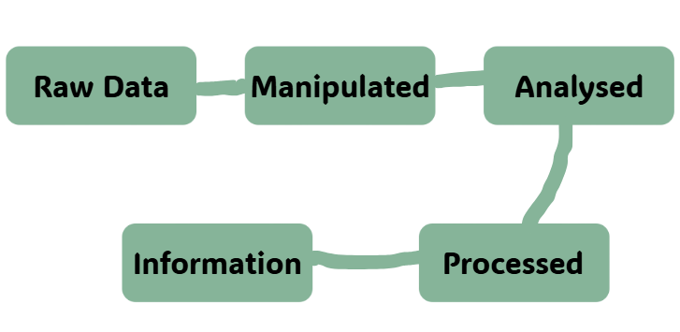

Slide 33
Manipulating
Changing, sorting, cleaning, or merging data
Example- removing duplicates, sorting by date
Notes:
Real World Example: HR teams merges attendance sheets from multiple sites

Slide 34
Analysing
Looking for patterns, trends or comparisons
Example: Calculating averages, counts, correlations
Notes:
Real World Example: Marketing team checks which adverts get the most clicks

Slide 35
Processing
Turning data into outputs or usable information
Example: Creating charts, dashboards or summaries
Notes:
Real World Example: Hospital system produces weekly reports on waiting times

Slide 36

Tinker - Messy Data Set
You have been given a messy data set. Your mission should you choose to accept it, is to manipulate, process and analyse it

Slide 37
Tinker - Messy Data Set
Go to the class notebook, ‘Class Handouts’ and open the ‘Data Manipulation Worksheet’

Slide 38
Self reflection
Success Criteria:
I can identify examples of manipulating, processing, and analysing data.
I can demonstrate transformations on a dataset.
I can explain how transforming data makes it useful.
Which one are you most confident in? Which one needs more practice?

Slide 39
Learning Objectives
-Describe how organisations use data and information for decision making
-Identify examples of data use
-Explain how data is transformed through manipulation, analysis and processing
-Judge the suitability and ethics of organisational data use

